Slide 1
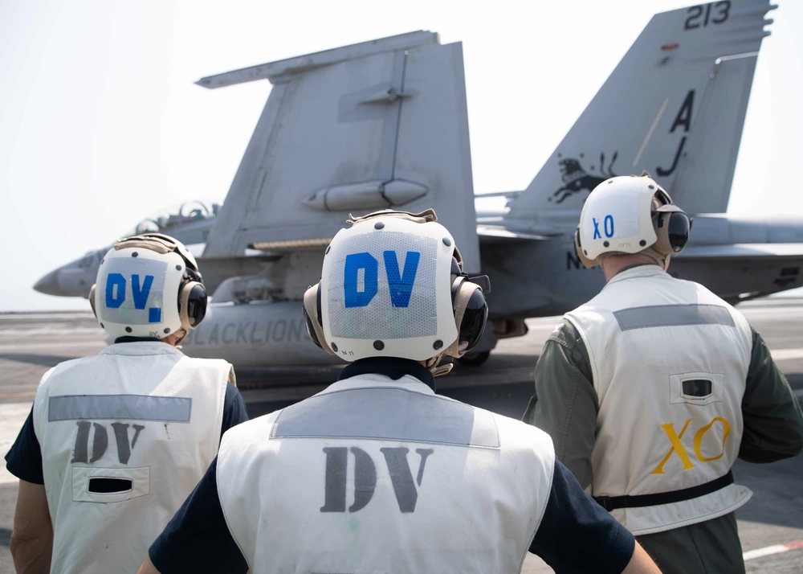

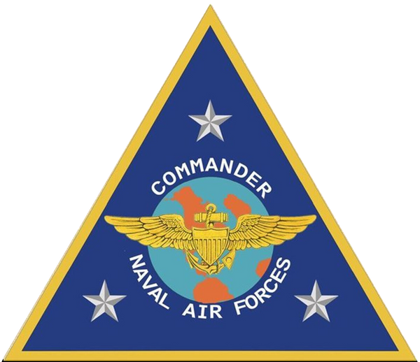
YOUR NAME
AIRCRAFT CARRIER EMBARK

Slide 2
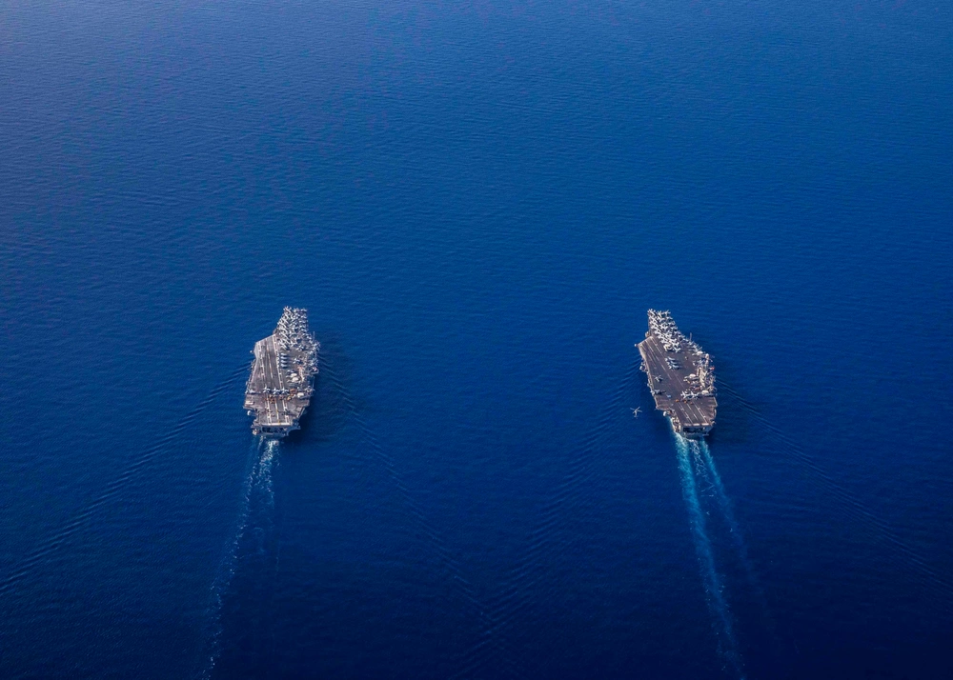


Operate with Allies and Partners to maintain a free and open maritime environment
80% of the world’s population lives within 100 miles of a coastline
100% of the time,
the U.S. Navy is deployed around the world
WHY WE NEED A NAVY
The Navy ensures uninterrupted flow of goods and communications
90% of the World’s communications lines pass under the oceans

Slide 3
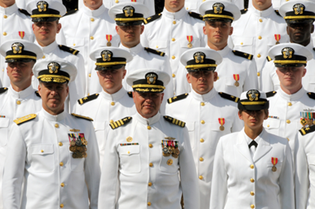
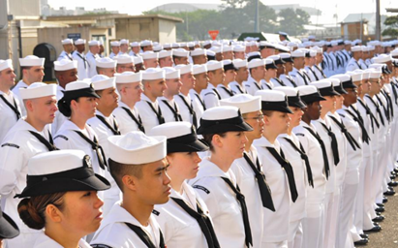
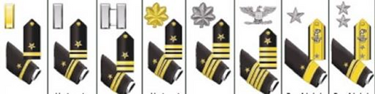
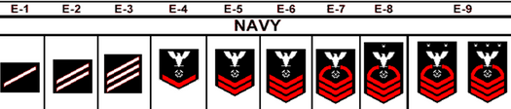
THE U.S. NAVY IS +300,000 STRONG
Officers
Enlisted
(W-1 to O-10)
(E-1 to E-9)
~55,500 Officers. Bachelor’s degree to enter with more opportunities for education during service.
~275,000 Enlisted Sailors. High School grads or greater to join. Specialized careers throughout service.

Slide 4

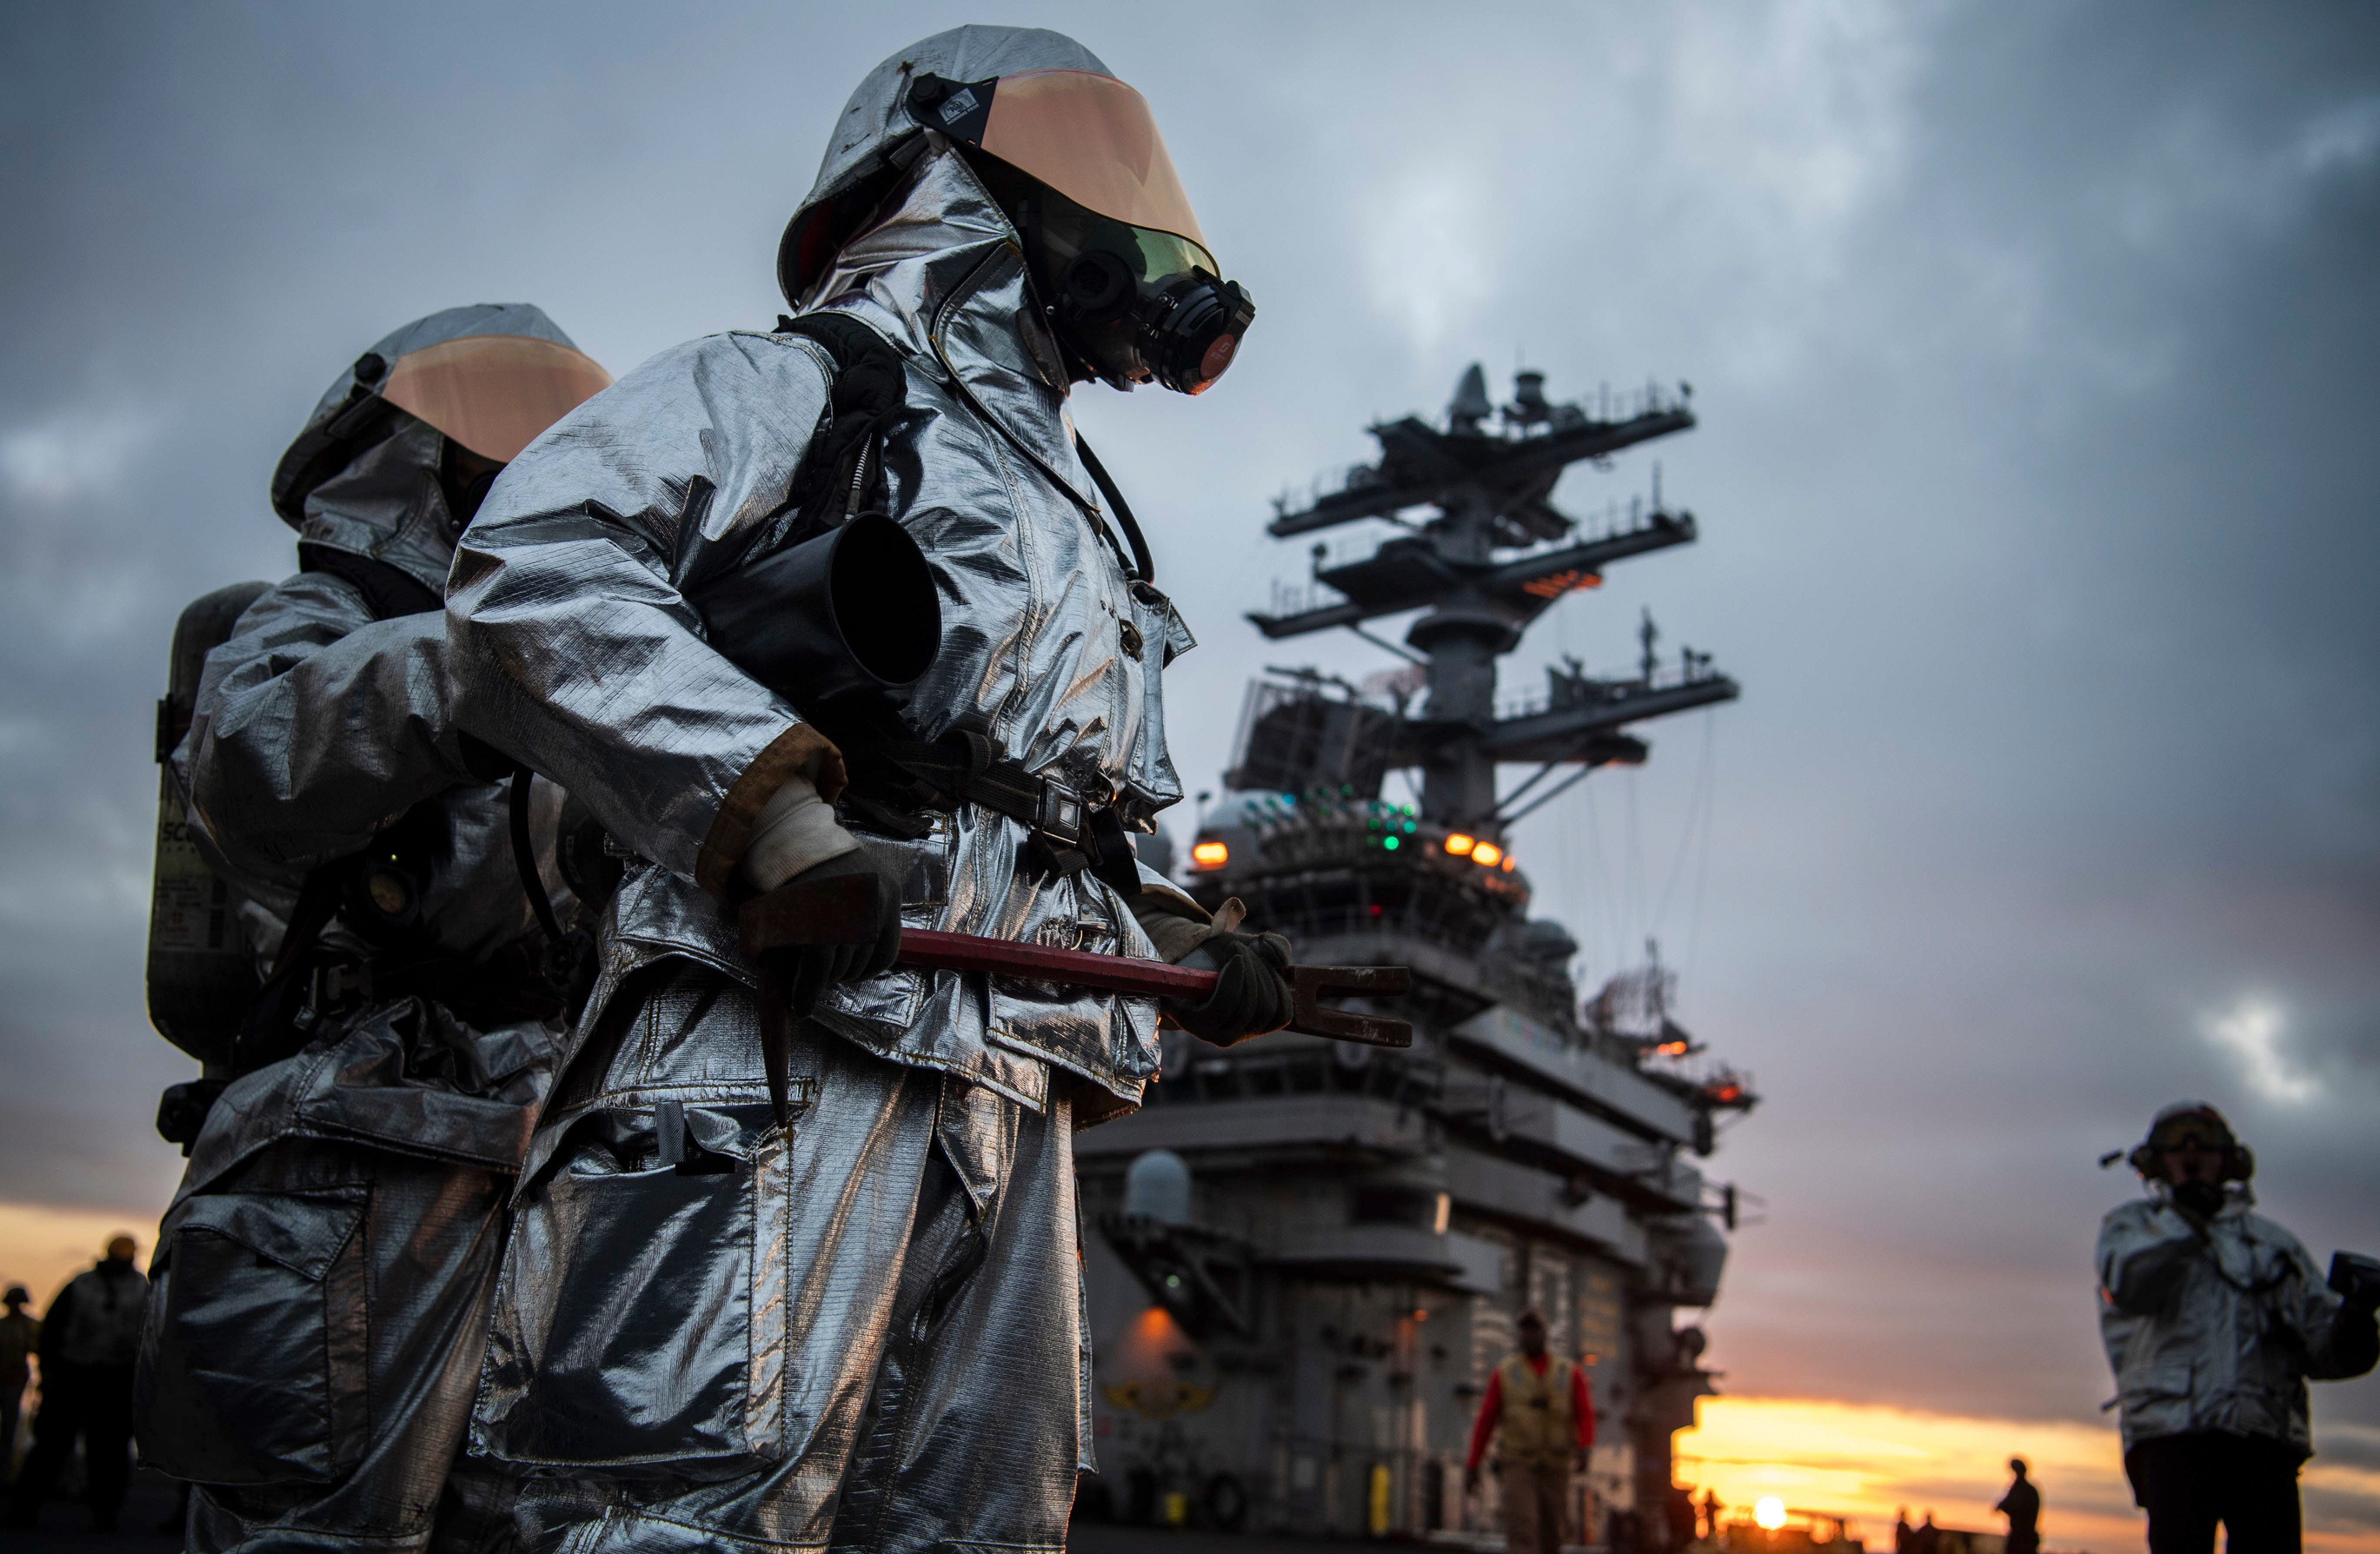
NAVY SAILORS
Highly Technical Workforce:
•Requires advanced skills
•Formal classroom
•On-the-job training
Ensured Combat Readiness:
•Career progression
•Rotation between deploying and non-deploying jobs
•Persistent training and drilling
•Sailors in today’s Navy are well-educated, highly trained and developed leaders.

Slide 5
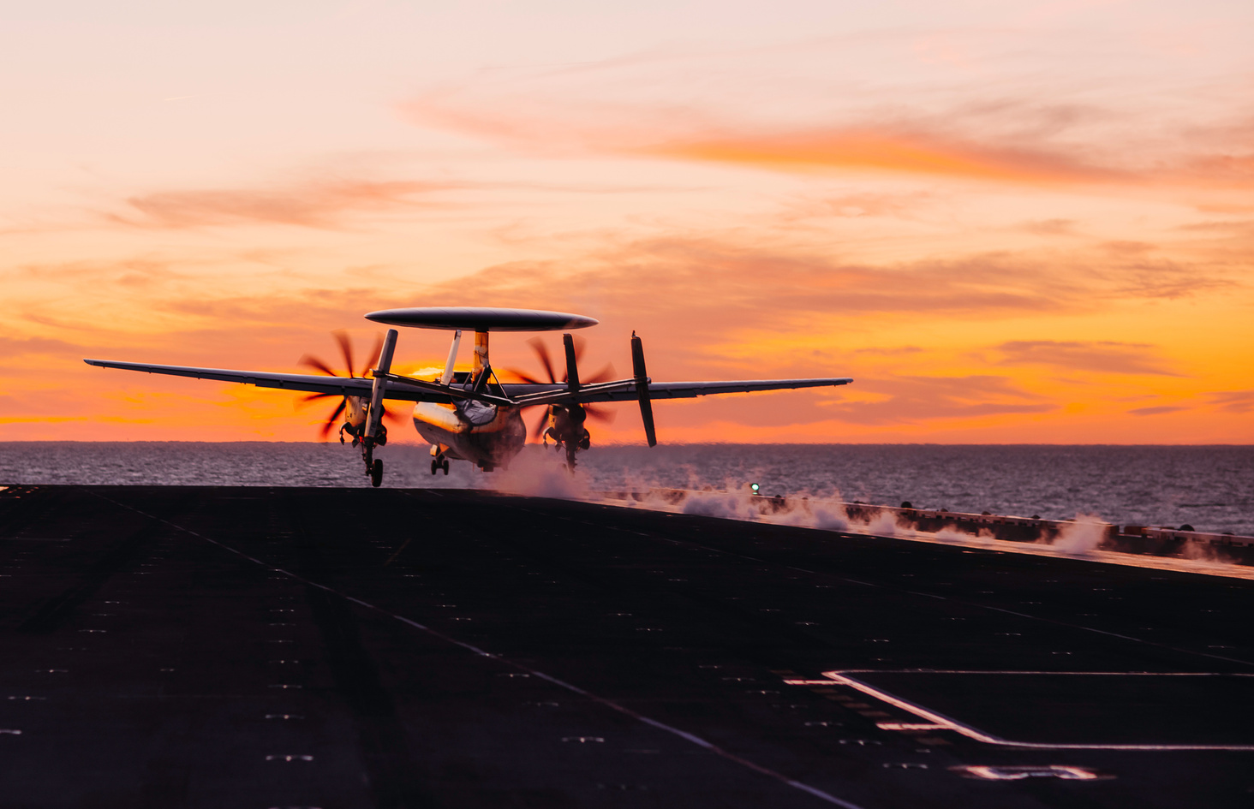
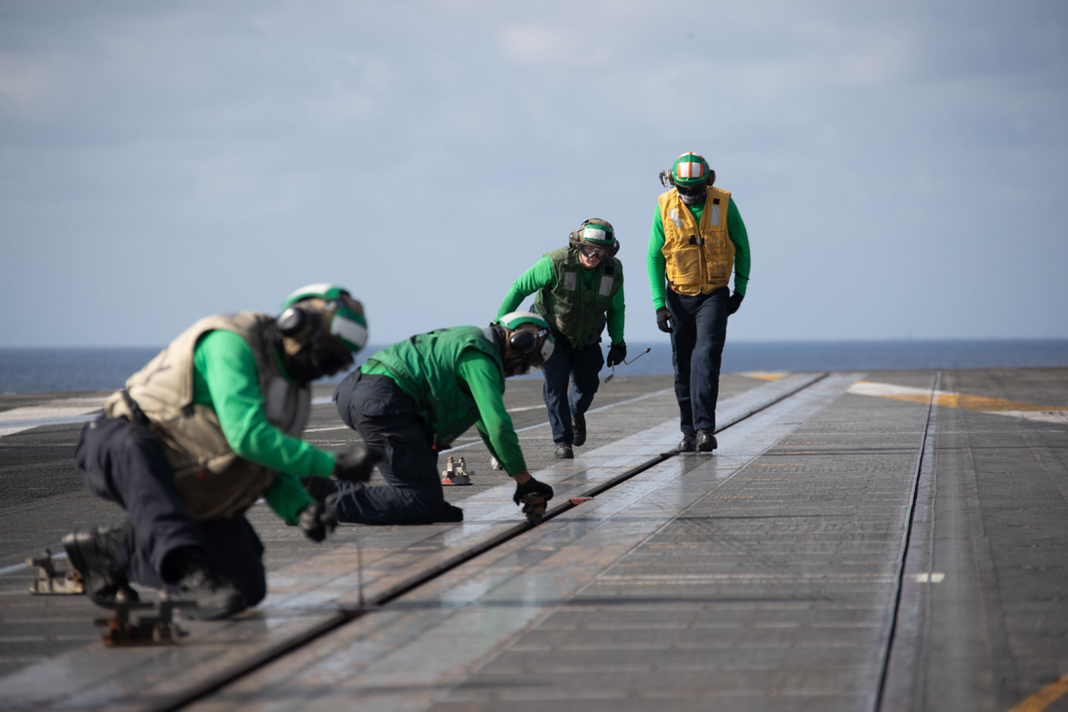
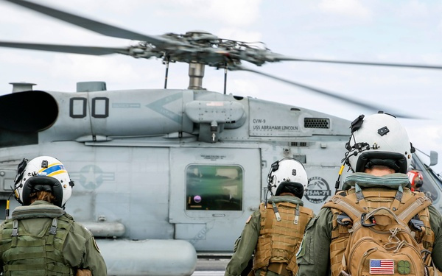
U.S. NAVAL AIR FORCES
Mission
Priorities
People & Platforms
“Man, Train, and Equip, deployable combat-ready Naval Aviation forces that win in combat.”
Warfighting
People
Readiness
100,000+ Sailors
2,806+ Aircraft
145 Squadrons

Slide 6
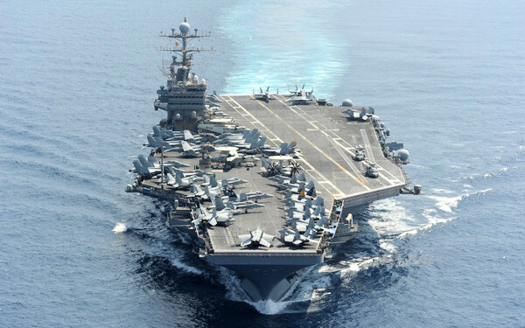
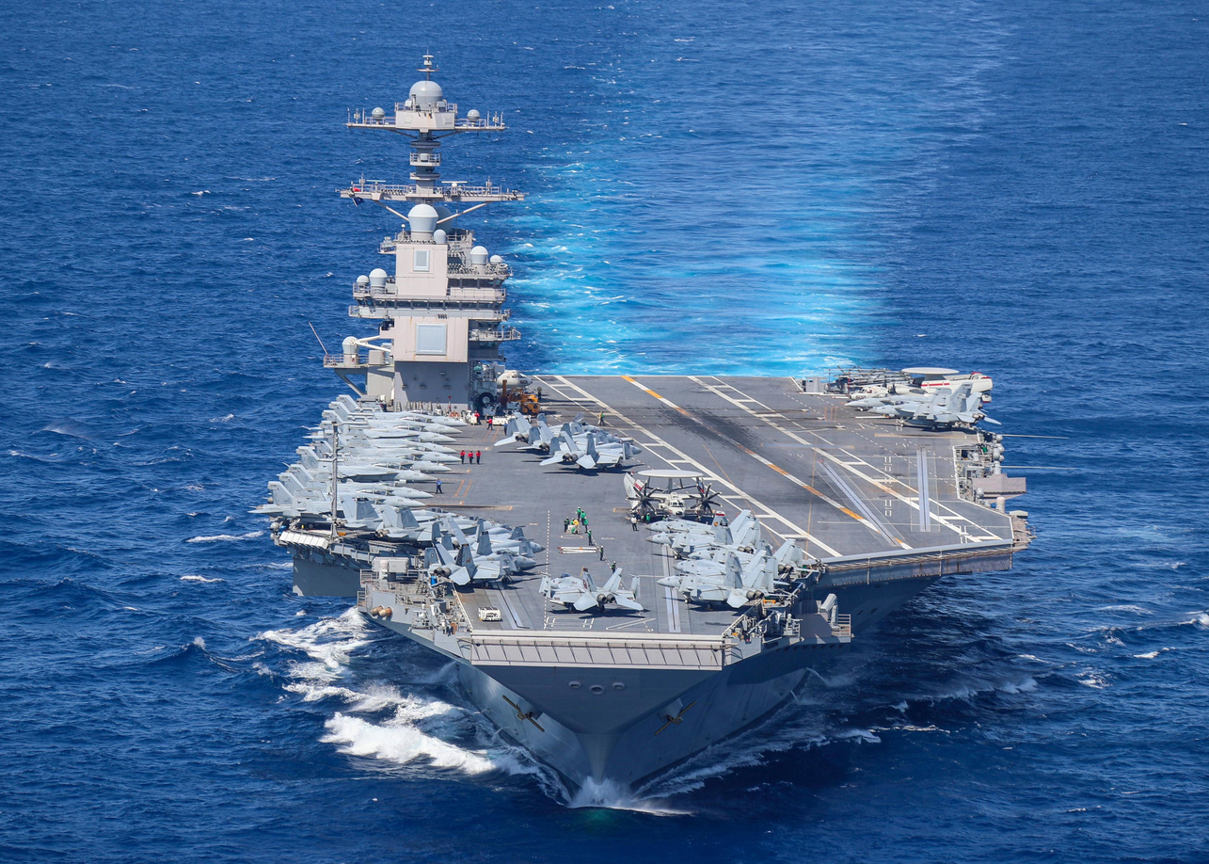
OUR NAVY’S AIRCRAFT CARRIERS
Nimitz Class
Ford Class
  Flight Deck Area: 4.5 acres
  Displacement: 97,000 tons
  Speed: 30+ knots
  Aircraft: 65+
  Personnel:
    Ship- 2,800
    Air Wing- 2,000
    Staff- 200
  Catapults: 4, steam powered
  Flight Deck Area: 4.6 acres
  Displacement: 100,000 tons
  Speed: 30+ knots
  Aircraft: 65+
  Personnel:
    Ship- 2,440
    Air Wing- 2,000
    Staff- 200
  Catapults: 4, Electromagnetic)
Combat-ready aviation capability: no need to rely on a foreign
nation’s airfield
Sustained high speed enables global transit, sustains maritime superiority, and brings unmatched lethality
On-call global air power can project power ~1,000 miles ashore
No other nation can match U.S. carrier capability

Slide 7

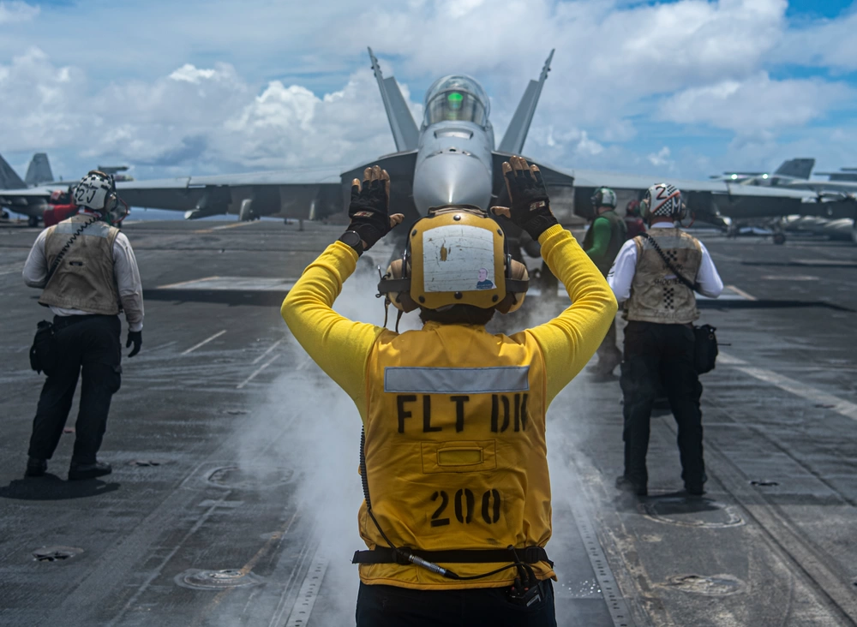
OUR NAVY’S AIRCRAFT
CARRIER BASED
  F/A-18 E-F ‘Super Hornet’
  EA-18G ‘Growler’
  F-35C ‘Lightning II’
  E-2D ‘Hawkeye’
  C-2A ‘Greyhound’
  MH-60R ‘Seahawk’
  MH-60S ‘Knighthawk’
SHIP/SHORE BASED
  CMV-22 ‘Osprey’
  MH-53 ‘Sea Dragon’
SHORE BASED
  EP-SE ‘Aries II’
  P-8 ‘Poseidon’
  E-6A/B ‘Mercury’
  C-40 ‘Clipper
OPERATIONAL UNMANNED
  MQ-8C ‘Fire Scout’
  MQ-4C ‘Triton’
  MQ-25 ‘Stingray’

Slide 8

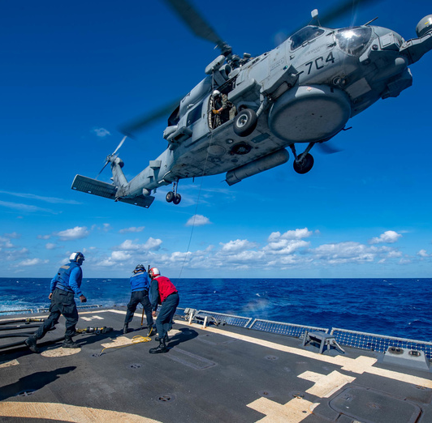
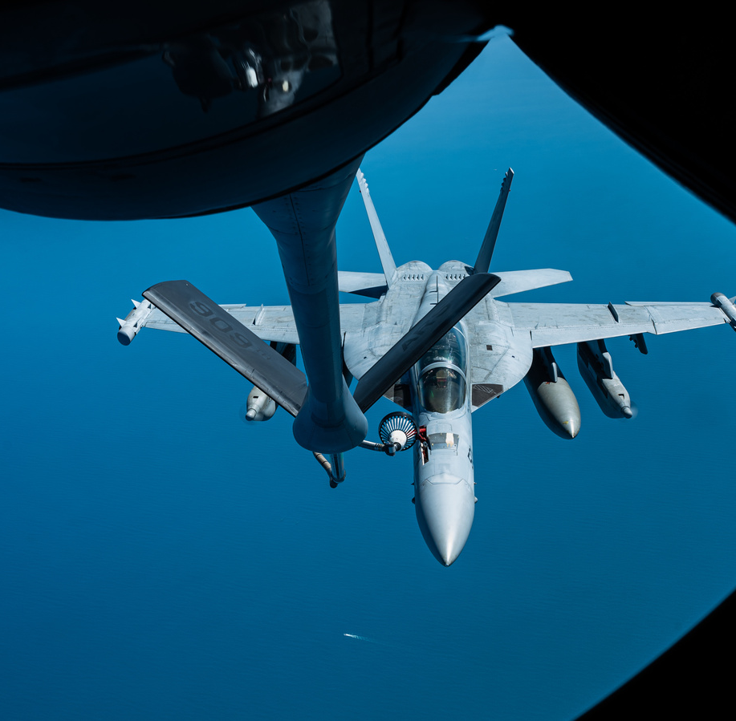
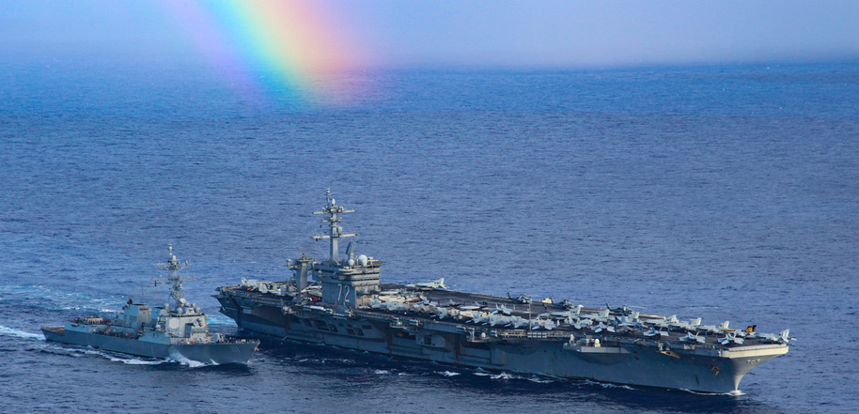
WHY WE DEPLOY
  Project power of combat ready Naval forces
    Diplomacy in action
    Visible presence for allies
    Crisis response
      Armed response
      Humanitarian aide

Slide 9
Your Photo Here
MY EMBARK EXPERIENCE
  Landing on Aircraft Carrier
  Observe Flight Operations
  Flight Deck and Vulture’s Row
  Meet the Captain & the Crew
  Engage Sailors
  Tour the ship
  Dining, Coffee & Ship’s Store
  Wardroom, CPO & Mess Decks
  Berth in 2-person stateroom
  Aircraft Departure to NAS North Island
Your Photo Here

Slide 10

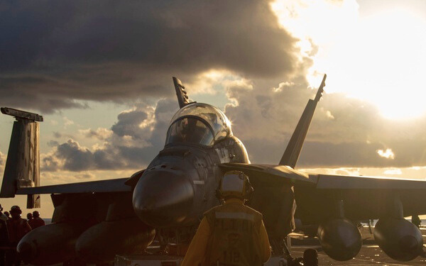


CNAF POINTS OF CONTACT
@U.S. Naval Air Forces
@usnavalairforces
CNAF PAO
CDR Beth Teach
(619) 767-1625
Beth.a.teach.mil@us.navy.mil
SOCIAL MEDIA
CNAF APAO
LTJG Gabe Wahl
(619) 545-4779
Gabriel.j.wahl.mil@us.navy.mil
CNAF DEPUTY PAO
MR. STEVE FIEBING
(619) 767-1622
steven.j.fiebing.civ@us.navy.mil

